Slide 1
CSS3: Lesson #7

Slide 2
Agenda
Responsive Web Designing (RWD)
Media types
CSS Media queries
Flexbox Box Model
Grid Layout Model
CSS Framework Bootstrap

Slide 3
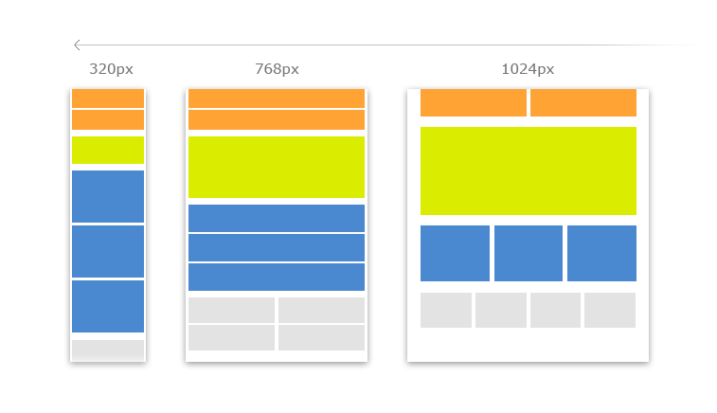
Problem

Slide 4
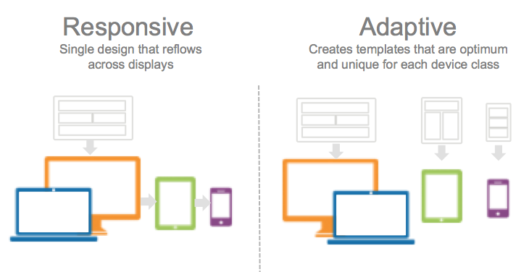
2 different solutions

Slide 5
Responsive Web Designing (RWD)
Responsive web designing is an approach where a website is built with fluid grids which fluidly change its layout to fit any screen size or device.

Slide 6
CSS Media queries
CSS Media queries were built as an extension to the commonly used media types.
It has ability to specify different styles for different browsers and devices by changing the width of the view port, device orientation, etc.

Slide 7
CSS Media queries
But, before we talk about media queries, we need to do a quick overview of media types.

Slide 8
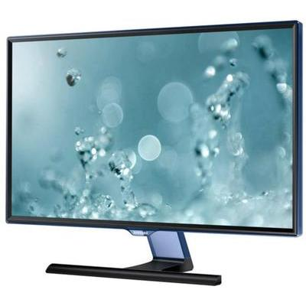
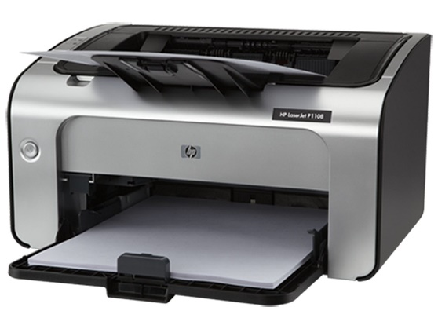
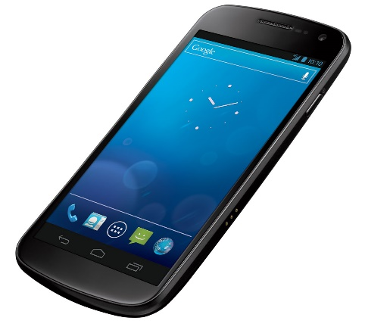
Media types
CSS can be used to specify how a document is presented in different media.

Slide 9
Media types. Types
all | Suitable for all devices.
handheld | Intended for handheld devices (typically small screen, monochrome, limited bandwidth).
print | Intended for paged, opaque material and for documents viewed on screen in print preview mode.
projection | Intended for projected presentations, for example projectors or print to transparencies.
screen | Intended primarily for color computer screens.
tv | Intended for television-type devices.

Slide 10
Media types. Declaration
There are four main methods that can be used to specify media for style sheets.

Slide 11
Media types. Declaration. Method #1:
You can use a <link> element in the head of your HTML document to specify the target media of an external style sheet.
<link rel="stylesheet" href="style.css"
type="text/css" media="screen" />

Slide 12
Media types. Declaration. Method #2:
You can use @import in the head if your HTML document to specify the target media of an external style sheet.
<style type="text/css" media="screen"> @import "style.css"; </style>

Slide 13
Media types. Declaration. Method #3:
You can specify the target medium within a CSS file using @import
@import url("style.css") screen;

Slide 14
Media types. Declaration. Method #4:
You can specify the target medium within a CSS file using @media
@media screen { body { color: red; } }
Notes:
P {
Color: red;
}
Span {
Color: red;
}

Slide 15
Media queries
You can use these four methods to define not only media types, but media queries.

Slide 16
Media queries. Declaration
A media query is a logical expression that is either true or false.
@media screen and (color) { ... }

Slide 17
Media queries. Declaration
A media query generally consists of a media type and zero or more expressions.
Logical expression
@media screen and (color) { ... }
Operator
Media type
Media feature

Slide 18
Media queries. Features
Media features are placed within brackets.
A media feature can be used without a media type or keyword.
The media type is assumed to be “all”.
@media (color) { ... }

Slide 19
Media queries. Features
Media features only accept single values: one keyword, one number, or a number with a unit identifier.
(orientation: portrait)
(width: 300px)
(color: 8)
(aspect-ratio: 16/9)

Slide 20
Media queries. Features list
width | Width of the viewport
height | Height of the viewport
aspect-ratio | Width-to-height aspect ratio of the viewport
orientation | Orientation of the viewport (portrait, landscape)
resolution | Pixel density of the output device
update | How frequently the output device can modify the appearance of content
color | Number of bits per color component of the output device, or zero if the device isn't color
monochrome | Bits per pixel in the output device's monochrome frame buffer, or zero if the device isn't monochrome
scripting | Is scripting (e.g., JavaScript) available?

Slide 21
Media queries. Prefixes
Most media features accept “min-” or “max-” prefixes.
Also you can use multiple expressions in a media query if you join them with the “and” keyword.
@media screen and (min-width: 250px)
and (max-width: 500px) { color: red; }

Slide 22
Media queries. Keyword “or”
You can also use multiple, comma-separated media queries.
The comma acts like an “or” keyword.
@media screen and (color),
handheld and (monochrome) { ... }

Slide 23
Media queries. Keyword “not”
You can use the “not” keyword in a media query if you want your CSS to be ignored by a specific device.
@media not screen and (color) { ... }
Notes:
(3;8) and (5;10) = (5;8)
(2;4) or [4;7) = (2;7)
Not (2;7)→ true=1, 8

Slide 24
CSS Flexbox Box Model
Good for controls, toolbars, menus, and forms that resize and reposition automatically when the user changes the size of the browser window.
Browser takes the available space and calculates the dimensions for the user.
Enables relative sizes and positioning.
Good tutorial: https://css-tricks.com/snippets/css/a-guide-to-flexbox/

Slide 25
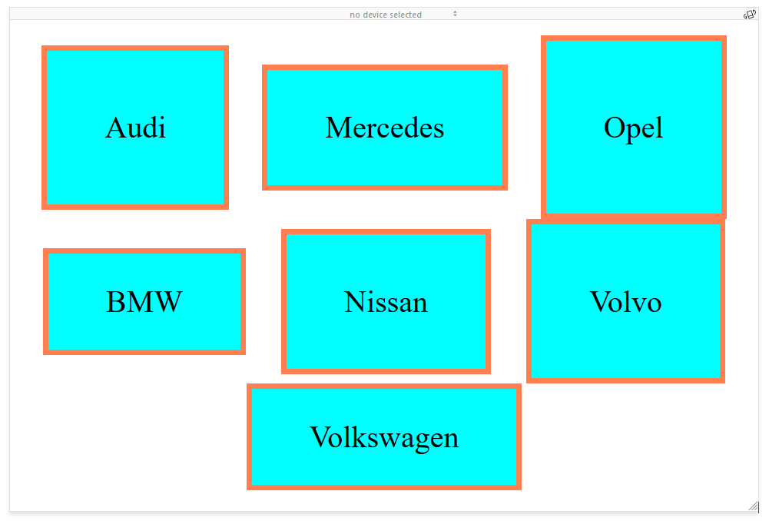
CSS Flexbox Model Example
.container { display: flex; list-style: none; flex-direction: row; flex-wrap: wrap; justify-content: space-around; align-items: center; } .container>li { display: flex; align-items: center; background-color: aqua; border: coral solid; padding-left: 30px; padding-right: 30px; }
<ul class="container"> <li style="height: 80px">Audi</li> <li style="height: 60px">Mercedes</li> <li style="height: 90px">Opel</li> <li style="height: 50px">BMW</li> <li style="height: 70px">Nissan</li> <li style="height: 80px">Volvo</li> <li style="height: 50px">Volkswagen</li> </ul>

Slide 26
CSS Grid Layout Model
Gives developers greater control over complex layouts than the flexbox model.
Lets you control the design of sections or entire HTML-based documents using CSS3.
Grid layouts use columns, rows, and cells, but you can move blocks of content from one part of page or application to another by moving code lines in CSS.
Good tutorial: https://css-tricks.com/snippets/css/complete-guide-grid/

Slide 27
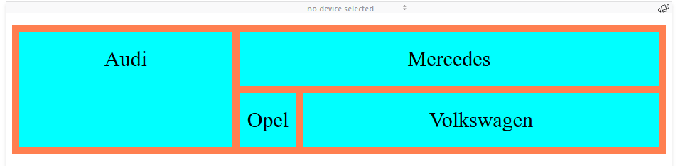
CSS Grid Layout Model Example
.grid-container { display: grid; grid-template-columns: 300px auto 500px; grid-gap: 10px; background-color: coral; padding: 10px; list-style: none; } .grid-container > li { background-color: aqua; text-align: center; padding: 20px 0; font-size: 30px; } #item-1 { grid-row: 1 / span 2; } #item-2 { grid-column: 2 / span 2; }
<ul class="grid-container"> <li id="item-1">Audi</li> <li id="item-2">Mercedes</li> <li>Opel</li> <li>Volkswagen</li> </ul>

Slide 28
CSS Framework Bootstrap
Bootstrap is an open source toolkit for developing with HTML, CSS, and JS.
Download compiled code for Bootstrap includes:
compiled and minified CSS bundles
compiled and minified JavaScript plugins
Notes:
<p class=“font”>

Slide 29
Once downloaded, unzip the compressed folder and you’ll see something like this:
Include layout, content, components, utilities
Use our powerful mobile-first flexbox grid to build layouts
Reboot, a collection of element-specific CSS changes in a single file

Slide 30
Bootstrap. CDN
You can use Bootstrap CDN, provided for free by the folks at StackPath CDN.

Slide 31
Bootstrap. CDN
Copy-paste the stylesheet <link> into your <head> before all other stylesheets to load our CSS.
<link rel="stylesheet"
href="https://stackpath.bootstrapcdn.com /bootstrap/5/css/bootstrap.min.css">
Notes:
www.getbootstrap.com

Slide 32
Bootstrap. CDN
Place the following <script>s near the end of your pages, right before the closing </body> tag, to enable them.
<script src="https://code.jquery.com/jquery-3.5.1.slim.min.js"> <script src="https://cdn.jsdelivr.net/npm/popper.js@1.16.1/ dist/umd/popper.min.js"> <script src="https://stackpath.bootstrapcdn.com/bootstrap/ 4.5.2/js/bootstrap.min.js">

Slide 33
Bootstrap. Grid system
Bootstrap’s grid system uses a series of containers, rows, and columns to layout and align content.
It’s built with flexbox and is fully responsive.

Slide 34
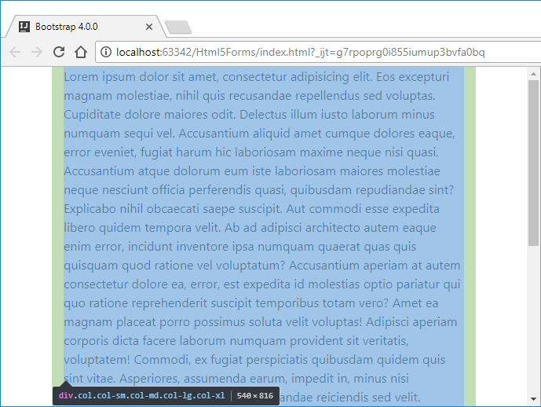
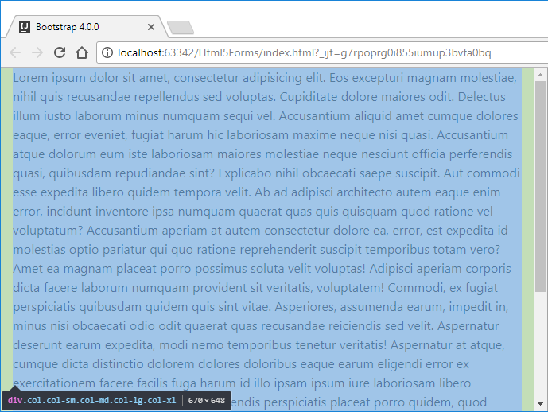
Bootstrap. Grid system
<div class="container"> <!-- Content here --> </div>
<div class="container-fluid"> <!-- Content here --> </div>

Slide 35

Bootstrap. Grid system
<div class="container"> <div class="row"> <div class="col"> One of three columns </div> <div class="col"> One of three columns </div> <div class="col"> One of three columns </div> </div> </div>

Slide 36
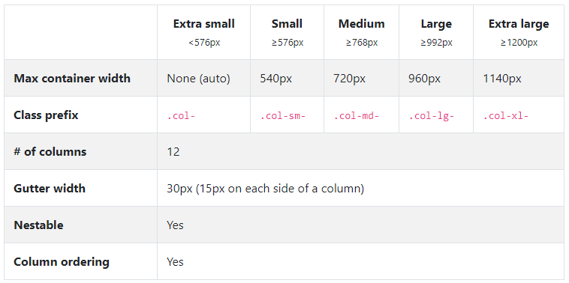
Bootstrap. Grid system

Slide 37
Bootstrap. Media queries
/* Extra small devices (portrait phones, less than 576px) */ @media (max-width: 575.98px) { ... } /* Small devices (landscape phones, 576px and up) */ @media (min-width: 576px) and (max-width: 767.98px) { ... } /* Medium devices (tablets, 768px and up) */ @media (min-width: 768px) and (max-width: 991.98px) { ... } /* Large devices (desktops, 992px and up) */ @media (min-width: 992px) and (max-width: 1199.98px) { ... } /* Extra large devices (large desktops, 1200px and up) */ @media (min-width: 1200px) { ... }

Slide 38
Bootstrap. Layout example
<div class="container"> <div class="row"> <header class="col" id="header">header</header> </div> <div class="row" id="row-2"> <div class="d-none d-sm-block col-sm-2 col-md-3" id="col-1-1">col-1-1</div> <div class="col-12 col-sm-8 col-md-6" id="col-1-2">col-1-2 <div class="row"> <aside class="col-5 offset-6" id="aside">sidebar</aside> </div> </div> <div class="d-none d-sm-block col-sm-2 col-md-3" id="col-1-3">col-1-3</div> </div> <div class="row"> <footer class="col" id="footer">footer</footer> </div> </div>

Slide 39
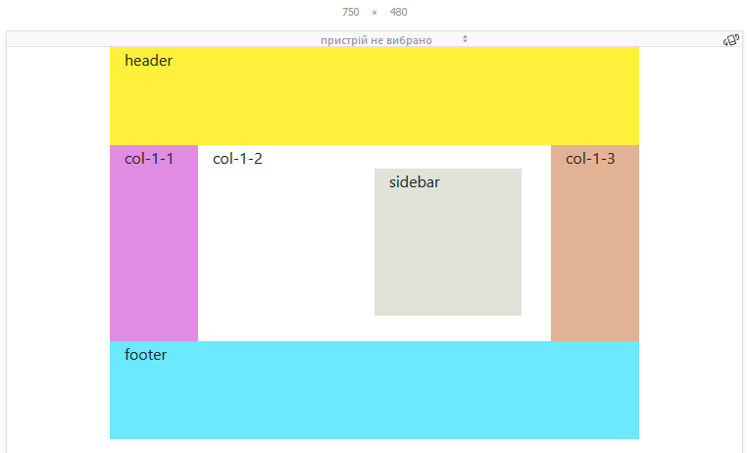
Bootstrap. Layout example

Slide 40
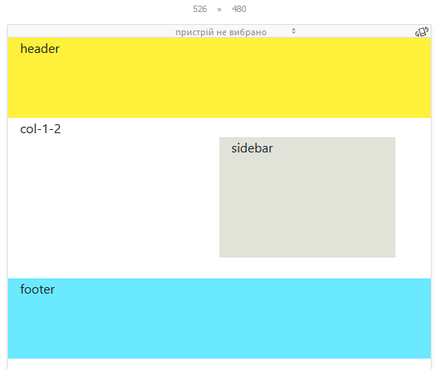
Bootstrap. Layout example

Slide 41
Practice Task

Slide 42
Contacts
Europe Headquarters
52 V. Velykoho Str.
Lviv 79053, Ukraine
Tel: +380-32-240-9090 Fax: +380-32-240-9080
E-mail: info@softserveinc.com
Website: www.softserveinc.com
US Headquarters
12800 University Drive, Suite 250 Fort Myers, FL 33907, USA
Tel: 239-690-3111 Fax: 239-690-3116
Thank You!

